Slide 1
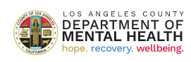
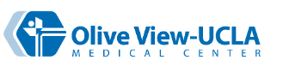
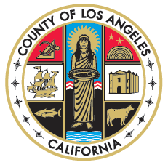
Sylmar Neighborhood Council Meeting
October 24, 2024
COUNTY OF LOS ANGELES
OLIVE VIEW-UCLA MEDICAL CENTER
Behavioral Health Projects

Slide 2
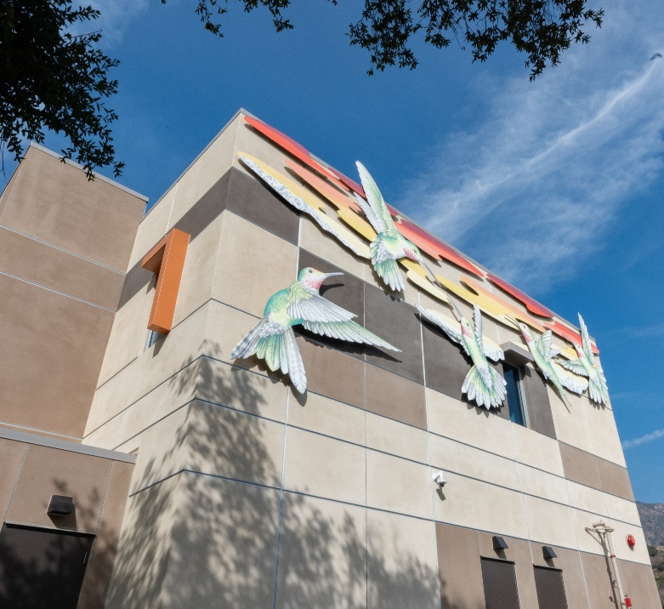
OLIVE VIEW CARE CONTINUUM PROJECT VISION
In 2019, the Olive View Master Plan was approved by the Board of Supervisors, based on combined input of County service departments as well as the local Community through meetings and work sessions that occurred over the course of two years
As part of the Master Plan vision and its focus on “whole-person” care, behavioral (mental health and substance use) health facilities and services are key components to the campus development
The State Behavioral Health Continuum Infrastructure Program (BHCIP) affords the County the opportunity to realize the Master Plan behavioral health facilities

Slide 3
MASTER PLAN DESIGN FEATURES
Key Design Features of the Master Plan aim to:
Re-capture the natural setting and resources unique to the Olive View area, including maintaining the walking and equestrian trails
Create more green spaces and places for patients, families, staff and the surrounding community to engage
Create gathering opportunities and spaces including quads, courtyards, gardens and encourage an interactive site
Reduce the inherent stress that can often go hand in hand with medical centers
And, overall. . . Provide an inviting component to the community

Slide 4
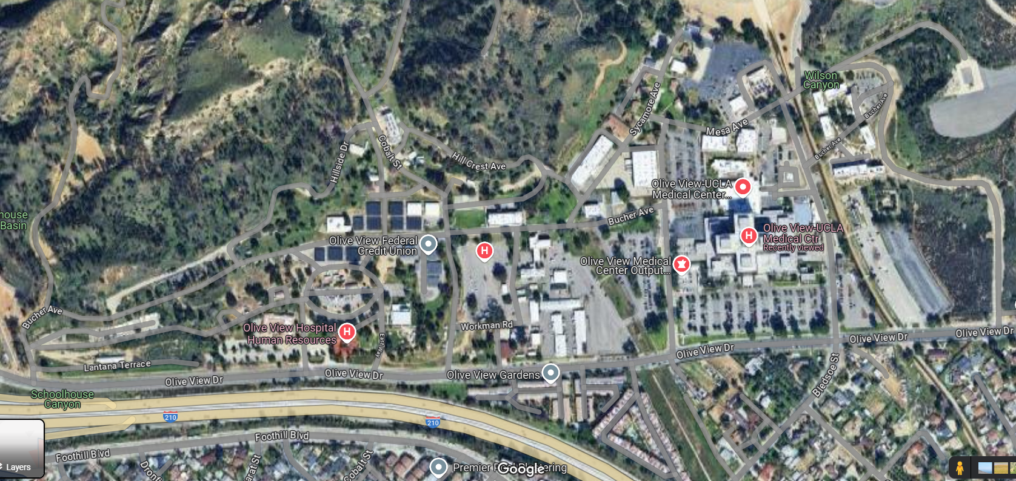
Phase 1
In summer 2021, the Restorative Care Village, first phase of behavioral health facilities was completed and included the Recuperative Care Center, Residential Treatment Programs, Mental Health Urgent Care Center, and Mental Health Wellness Center (in yellow highlight)

Slide 5

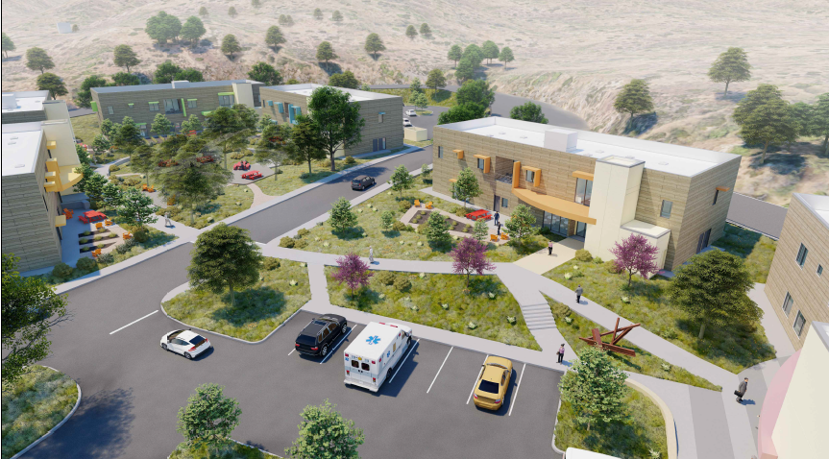
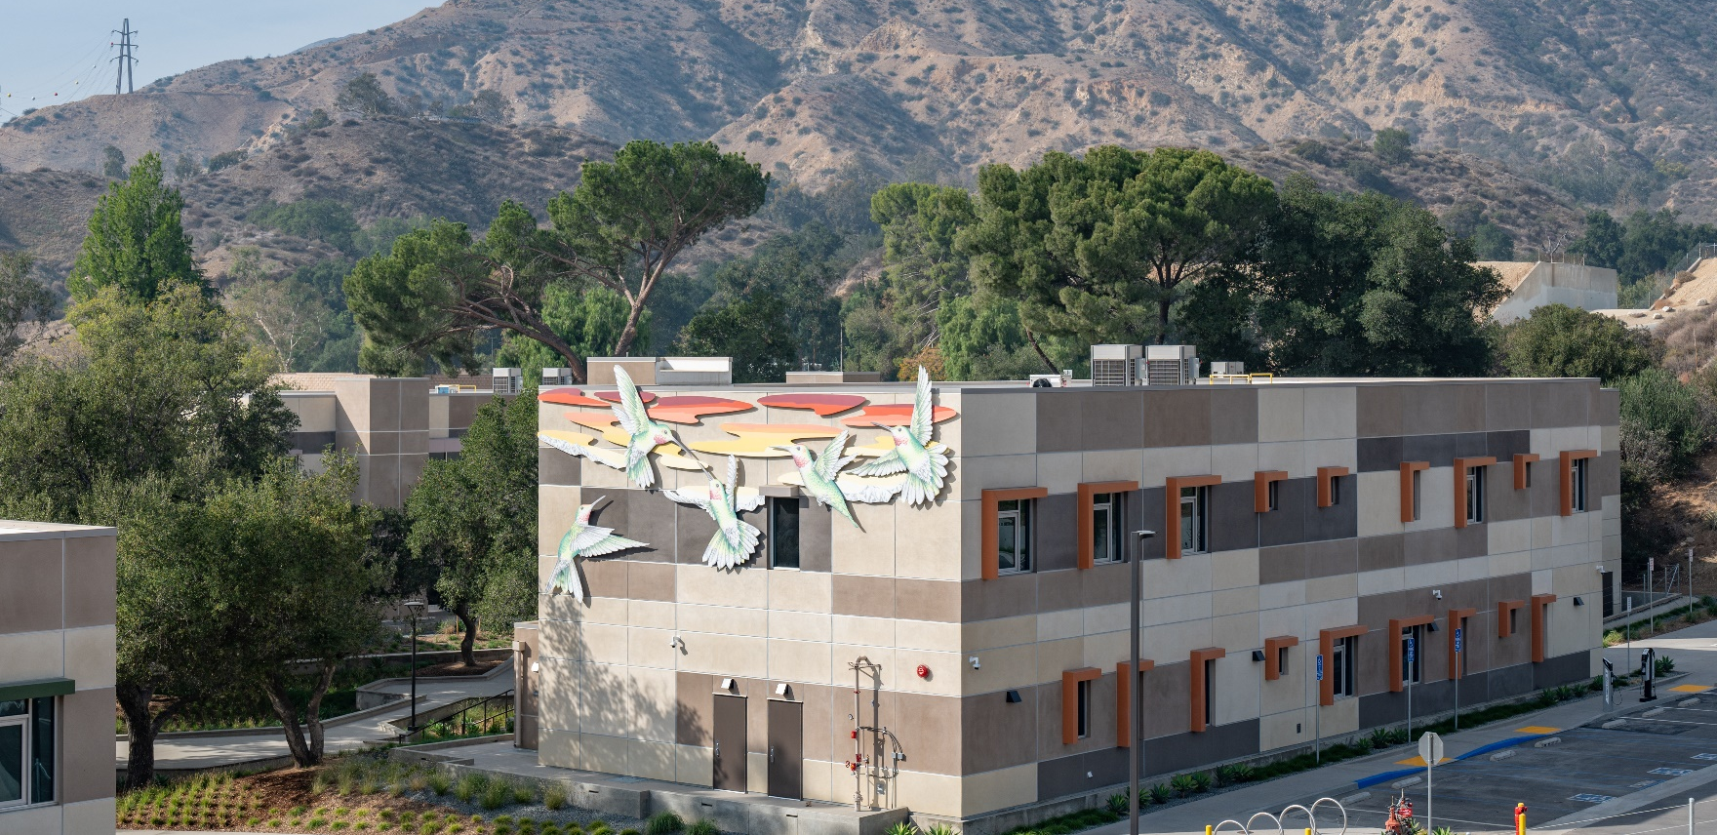
Olive View-UCLA Medical Center RCV
The RCV aimes to create healing indoor and outdoor settings that maintain the trails and outdoor spaces of the Olive View Campus as reflected by the Master Plan community input.

Slide 6
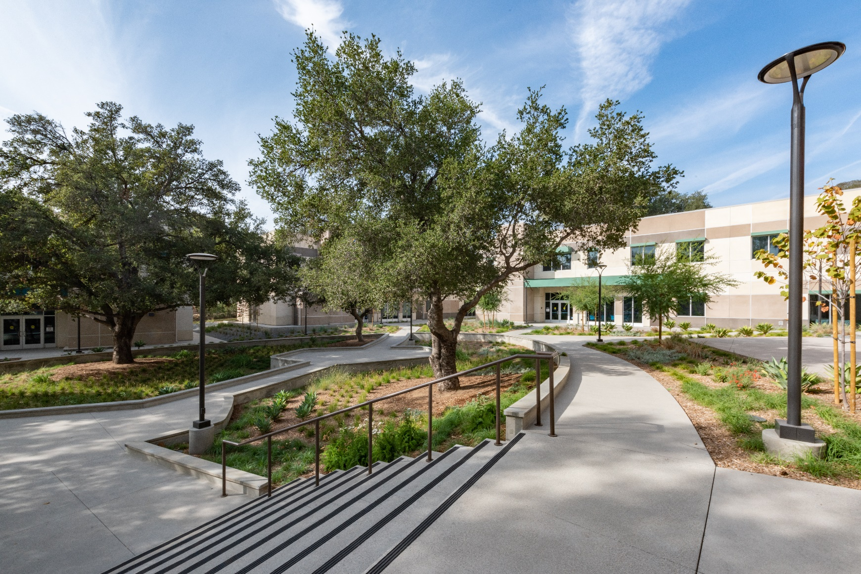
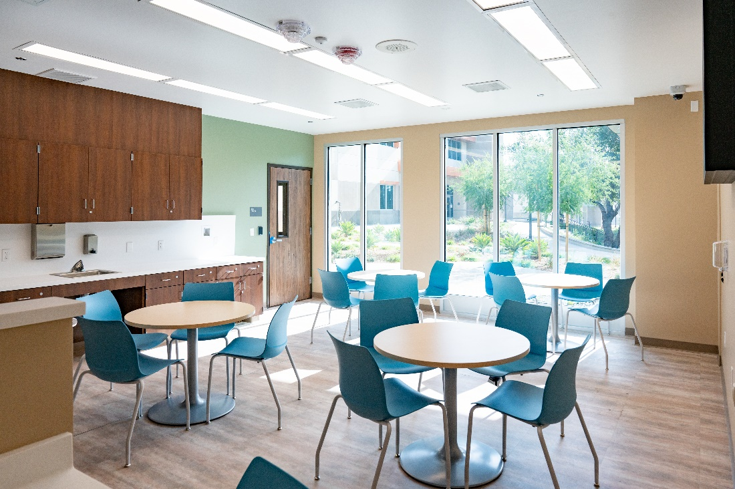

Slide 7
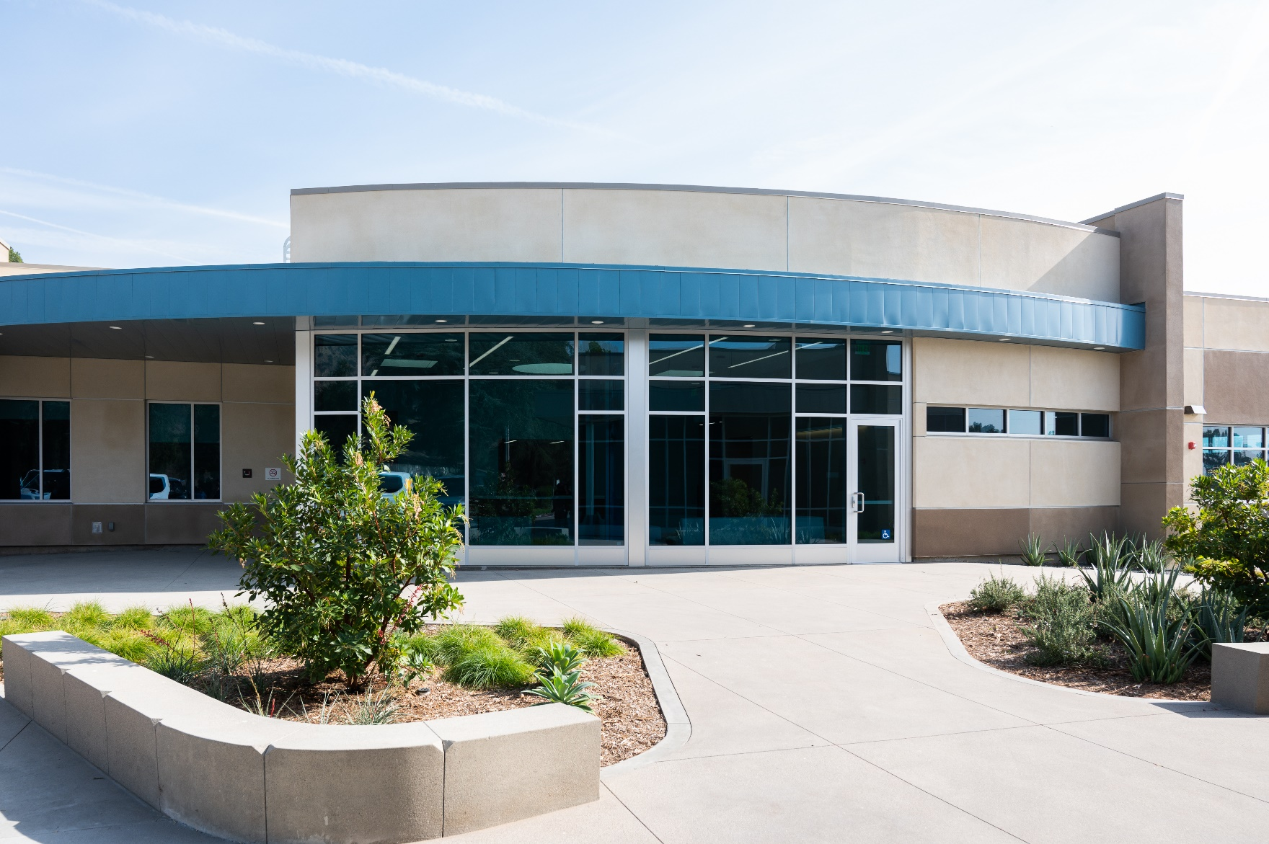
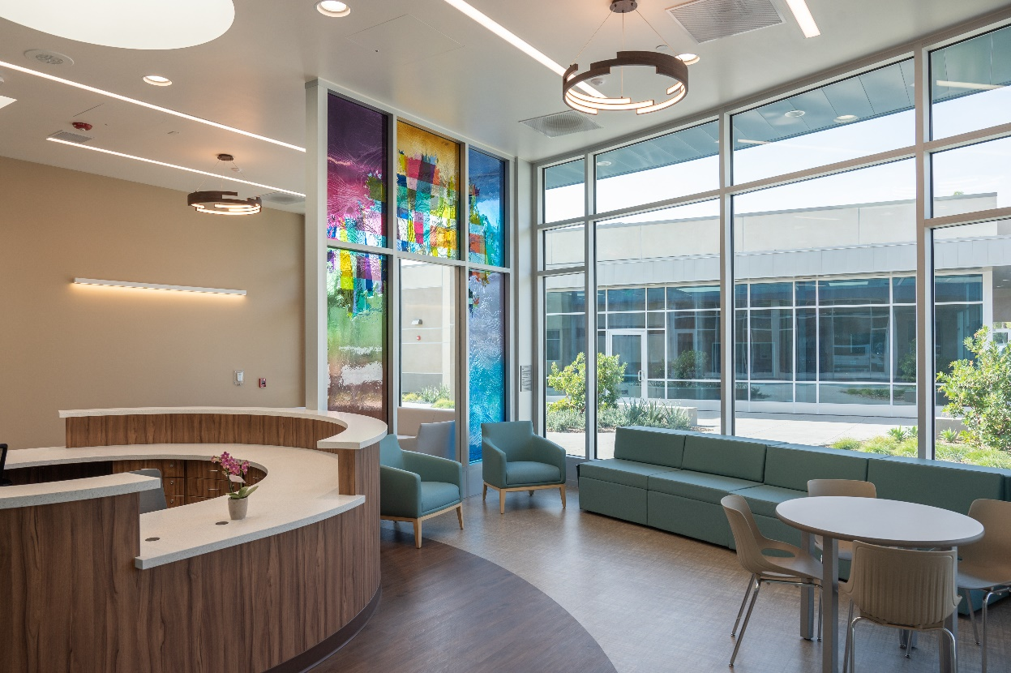

Slide 8
Regional Behavioral Health Infrastructure Needs
There is a regional need to add beds across the County.
Priority needs are for subacute and residential facility types.
BHCIP funding prioritizes campus-type models that co-locate multiple levels of care.
This project enhances a continuum of care model on the Olive View-UCLA Medical Center campus.
This project creates “client flow” between critical levels of care and will connect to and compliment the Crisis Residential Treatment Programs (CRTP) on campus currently.

Slide 9
$3.3B
Bond BHCIP Round 1: Launch Ready
(Due Dec 13, 2024)
BHIBA $6.38 billion general obligation bond
Community –Based Organization Applications
County Applications
Prop 1 Bond BHCIP Round 1 Launch Ready
$1.1B
BHCIP Round 2: Unmet Needs
(mid-2025)
BH treatment and residential settings
County Letter of Support required by DHCS
Support construction, renovation, and/or expansion of treatment and residential facilities to build up the regional system of care.

Slide 10
Phase 1
Proposed
The new proposed project will include 48 treatment and residential beds located on the west end of campus (in orange highlight)

Slide 11
County BHCIP Project
OLIVE VIEW CONTINUUM OF CARE FACILITY
Facility Levels of Care | Service Description
Psychiatric Health Facility (PHF) Number of beds: 16 | PHFs are an alternative to acute psychiatric hospitals. They provide locked, 24-hour acute inpatient psychiatric treatment to individuals with major mental disorders in a non-hospital setting with the goal of being a short-term placement and moving a person to the least restrictive setting as soon as possible. They may admit and treat only patients who have no physical illness or injury that would require inpatient treatment.
Mental Health Rehabilitation Center (MHRC) Number of beds: 16 | Is a locked, 24-hour program, licensed by DHCS, which provides support and rehabilitative services designed to assist persons, 18 years and older, with mental disorders who would have been placed in a state hospital or another health mental facility.
Enriched Residential Services (ERS) Number of beds: 16 | Provides comprehensive mental health and rehabilitative services in a non-institutional residential setting for individuals 18 and older. Accommodates persons discharged from a locked subacute, acute psychiatric inpatient units, jails, or intensive residential facilities at risk of needing higher level of care. ERS is an open setting level of care focusing on life skills training, linkage and community engagement activities that aims to stabilize, prepare, and transition individuals to a stable independent community living environment.

Slide 12
NEXT STEPS
PRELIMINARY SCHEDULE COMPLETION DATE
BHCIP Application Submission December 13, 2024
BHCIP Notification of Approval* May 2025
Preliminary Design June 2025
Start of Construction January 2026
Construction Completion January 2028
Licensing Process August 2028
*If funding is awarded, a project website will be established to monitor progress*

Slide 13
CONTACT INFORMATION
For questions please contact:
Supervisor Lindsey Horvath’s Office, Third District
Savannah Portillo Heap
SHeap@bos.lacounty.gov
(213) 595-9198

Slide 14
Questions
Notes:
When we submit and if awarded.

